Slide 1

Disease Spread Simulation on Social Networks
A Data Structures & Algorithms Project
Presented by Alap Gohar, Abdullah Khalil, Sikandar Hussain

Slide 2

Modeling Disease Spread Using Graph Algorithms
Problem Statement
Core DSA Components
Simulate epidemic transmission on 1000+ node social networks
Model "hub nodes" (super-spreaders) in scale-free networks
Graph Data Structure
Adjacency List for O(V+E) space efficiency
Network Generation
Barabási-Albert Algorithm
Disease Propagation
Modified BFS (Breadth-First Search)
Probabilistic Model
Monte Carlo simulation for infection

Slide 3


Network Generation: Barabási-Albert Model
Preferential Attachment
Algorithm Characteristics
Time Complexity: O(V × m)
Space Complexity: O(V + E) with Adjacency List
Output: Scale-free network, power-law distribution, hub nodes
Adjacency List Advantage: 99% memory savings vs. matrix for sparse graphs
New nodes connect based on existing node degree
Formula: P(connect to node i) ∝ degree(i)

Slide 4
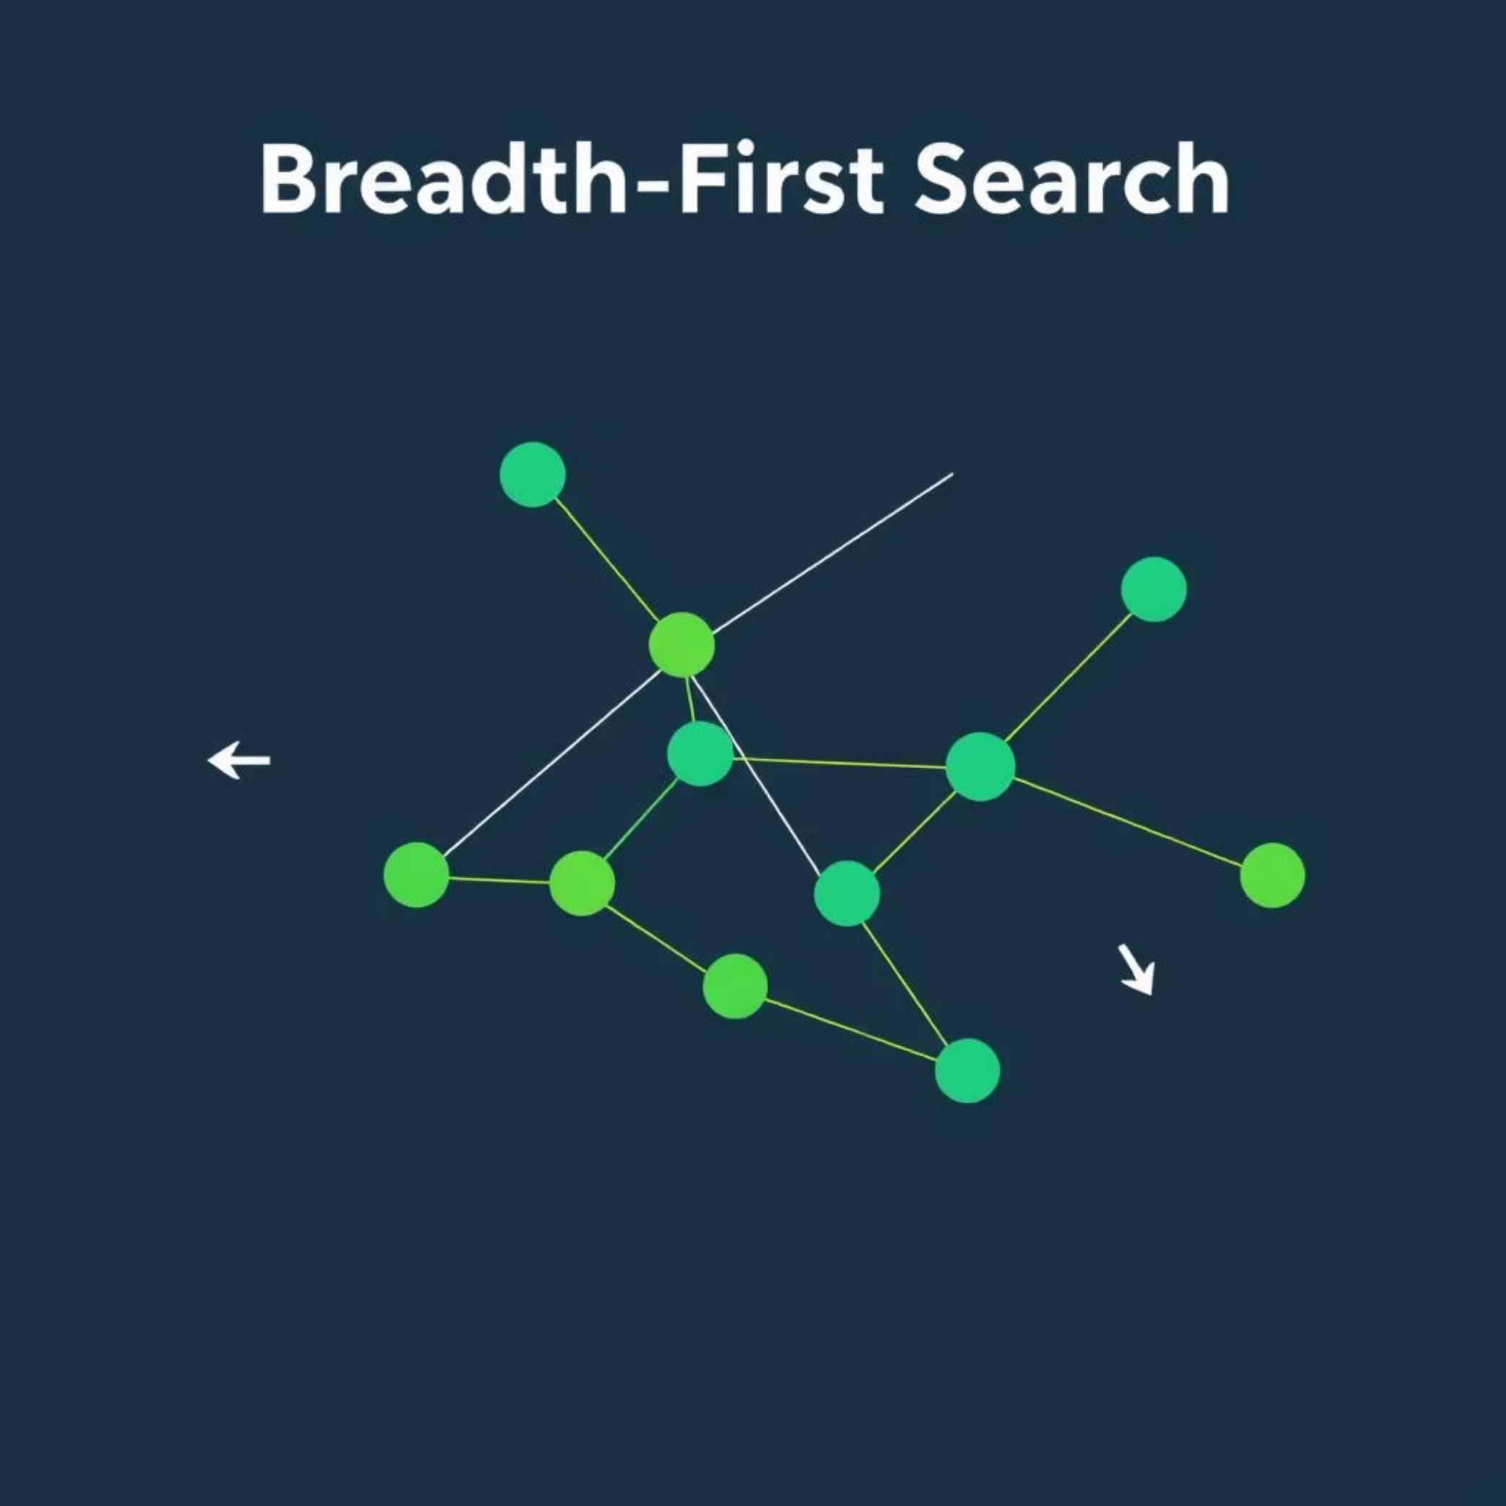
Disease Propagation Algorithm: Modified BFS
BFS-Based Infection Spreading
Algorithm Type: Modified Breadth-First Search
Time Complexity: O(V + E) per time step
Space Complexity: O(V) for state tracking
Total Simulation: O(T × (V + E)) where T = time steps
Why BFS? Effectively models disease transmission waves, level-by-level.

Slide 5

Simulation in Action: Live Demo
Experience the dynamic spread of disease on a custom-generated social network.
01
02
Network Generation
Simulation Launch
500 nodes, m=3 edges per new node
Start with 30% infection probability
03
04
Observe Spread
Real-time Data
Watch step-by-step infection, identify hub node impact
Visualize infection timeline and statistics

Slide 6
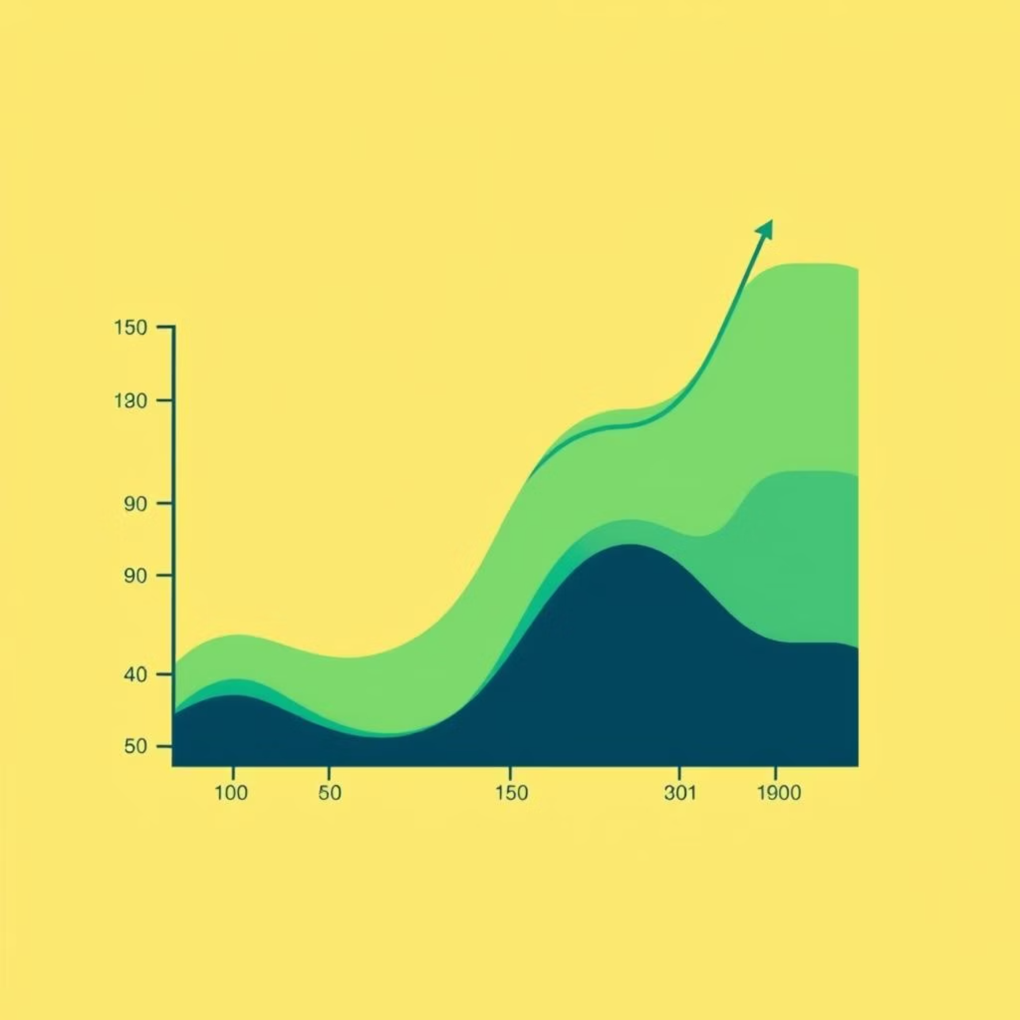
Performance Analysis & Key Findings
Efficiency Metrics
Key Results
Operation
Time (1000 nodes)
Complexity
Infection Rate: 30% transmission → 60% population infected in ~20 steps
Hub Node Impact: Accelerate spread by 3x
Network Generation
0.5s
O(V × m)
Memory Optimization: Adjacency list provides 99% savings
Simulation Step
0.02s
O(V + E)
Scalability: Doubling nodes ≈ doubling time (linear growth)
Memory Usage
5MB
O(V + E)
Visualization
60 FPS
O(V log V)

Slide 7
Work Division
Team Member | Responsibilities
Alap Gohar | Barabási–Albert algorithm implementation. Network generation & adjacency list structure. Performance optimization & testing
Abdullah Khalil | Modified BFS disease propagation algorithm. Monte Carlo simulation logic. Algorithm complexity analysis
Sikandar Hussain | Frontend UI/UX developmentD3.js / Three.js visualization implementationReal-time statistics & charting

Slide 8
Questions?

